Slide 1

Facial Attendance: Integrating AWS for Seamless Attendance Tracking
Facial attendance systems powered by AWS services offer a cutting-edge solution for organizations to streamline employee attendance management. This integrated approach leverages the power of facial recognition technology and cloud computing to deliver a seamless, secure, and efficient attendance tracking experience.

Slide 2
Integration with AWS Services
AWS Rekognition
AWS Lambda
AWS IoT Core
Leverages the advanced facial recognition capabilities of AWS Rekognition to accurately identify employees and track attendance.
Serverless functions that automate attendance logging and integrate with other AWS services for a seamless workflow.
Enables secure and scalable connectivity between on-premise attendance devices and the AWS cloud.

Slide 3
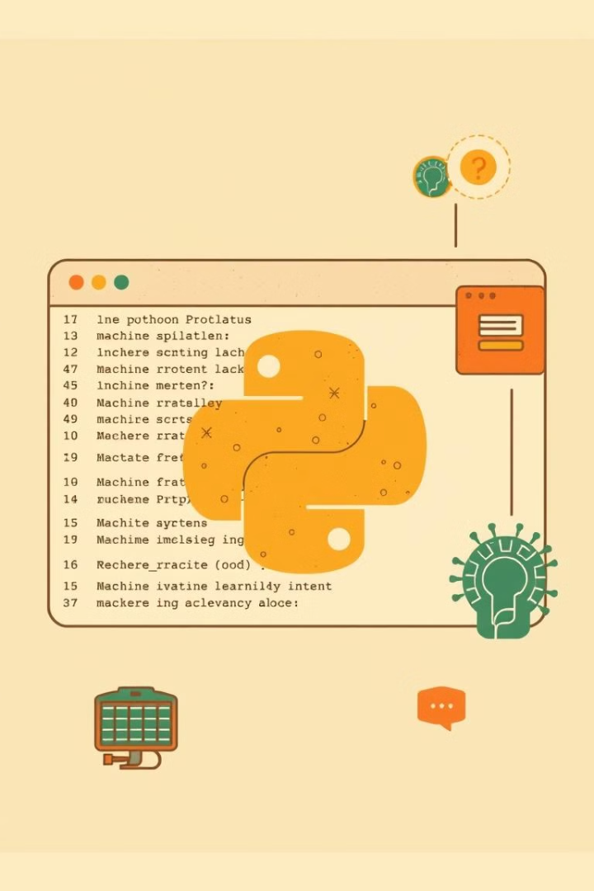
Python and Machine Learning for Facial Recognition
1
Data Preparation
Collect and preprocess employee facial data to train the machine learning model.
2
Model Training
Use deep learning techniques to develop a robust facial recognition model.
3
Model Deployment
Integrate the trained model with the attendance system and AWS Rekognition for real-time identification.

Slide 4
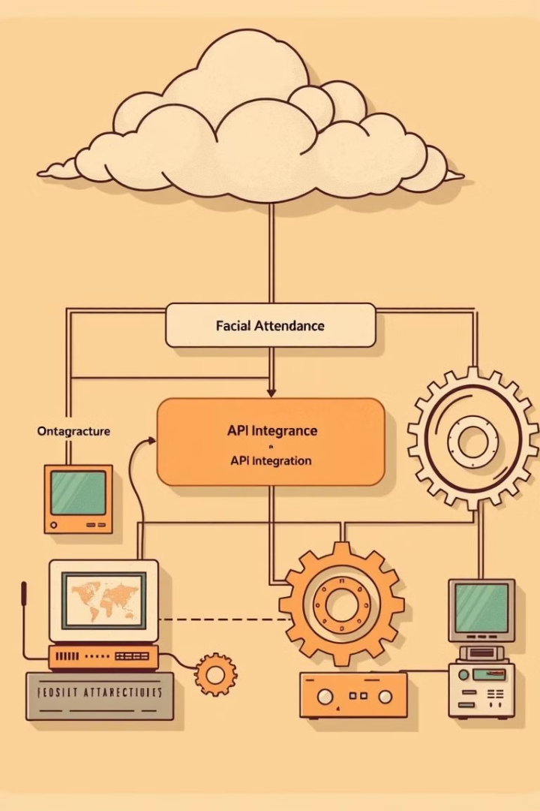
System Architecture and Components
On-Premise Devices
AWS Services
Cameras and sensors installed at entry/exit points to capture employee facial data.
Rekognition, Lambda, IoT Core, and other AWS services that power the attendance system.
Attendance Management
Software interface for employees to view their attendance records and for HR to manage the system.

Slide 5




Error Handling and Redundancy
Fault Tolerance
Redundant components and failover mechanisms to ensure system availability and reliability.
Error Monitoring
Real-time monitoring and automated alerts for quick resolution of any system issues.
Data Backup
Secure and redundant data storage to protect attendance records and employee information.

Slide 6




Implementing Facial Attendance
Facial Capture
Attendance Logging
Attendance Dashboard
Strategically placed cameras at entry/exit points to capture employee facial data.
Automated logging of employee arrival and departure times in the attendance database.
Intuitive interface for employees and HR to view and manage attendance records.

Slide 7
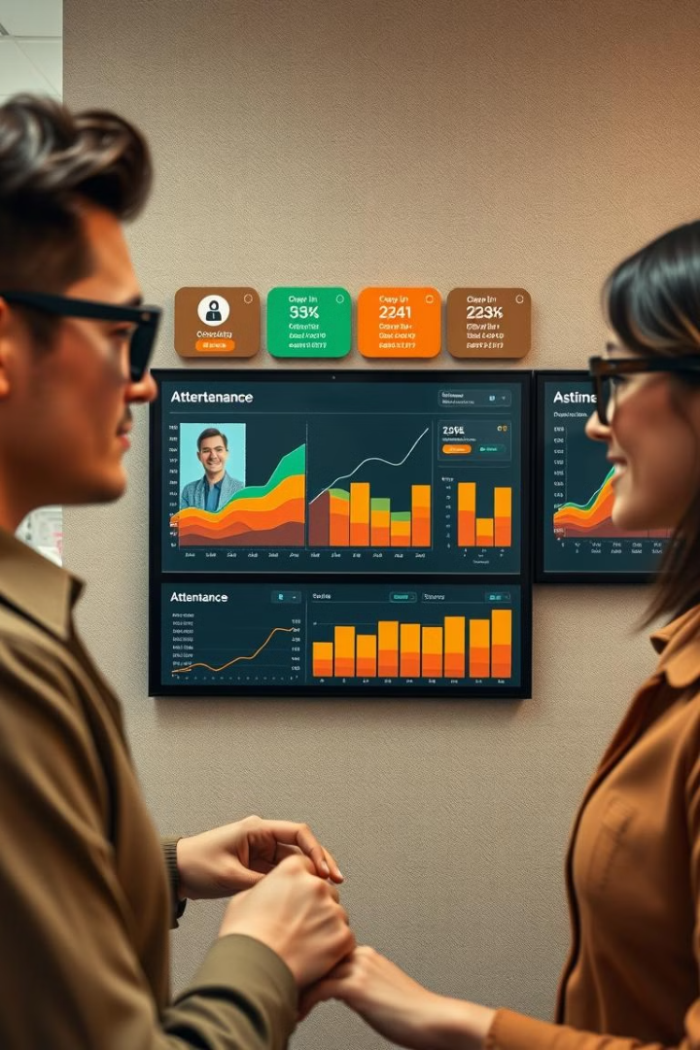
Results and User Experience
1
Increased Accuracy
2
Time Savings
Facial recognition technology ensures reliable and tamper-proof attendance tracking.
Automated attendance logging eliminates manual record-keeping and reduces administrative overhead.
3
Improved Visibility
Real-time attendance data and analytics provide valuable insights for HR and management.

Slide 8

Data Security and Privacy
Encryption
All employee data is stored and transmitted in an encrypted format to ensure confidentiality.
Access Control
Granular access permissions and multi-factor authentication safeguard sensitive information.
Compliance
The system adheres to relevant data protection regulations and industry best practices.

Slide 9
System Performance
Low Latency
High Throughput
Scalability
Rapid facial recognition and attendance logging, ensuring a seamless user experience.
Ability to handle large volumes of employee traffic and data processing demands.
Seamless scaling of the system to accommodate growing organizational needs.

Slide 10

Future Enhancements and Roadmap
Multimodal Biometrics
Mobile Integration
Integrating additional biometric modalities, such as iris or palm recognition, for enhanced security.
Developing mobile apps for employees to easily access and manage their attendance records.
AI-Driven Analytics
Leveraging machine learning to provide predictive insights and optimize attendance patterns.

